Slide 1
Large-Scale Cross-Document Coreference Using Distributed Inference and Hierarchical Models
SLIDES BY BEN HIXON
HUNTER COLLEGE
EPSTEIN LAB
3/26/2012
Sameer Singh¹, Amarnag Subramanya²,
Fernando Pereira², Andrew McCallum¹
¹Department of Computer Science, University of Massachusetts, Amherst
²Google Research, Mountain View CA
Presented at the 49th annual meeting of the Association for Computational Linguistics (ACL 2011)

Slide 2
Outline
Problem: How to link mentions to their correct entities when mentions are contained in many documents
Proposed solution: Distributed, Hierarchical MCMC
Review Graphical Models and Factor Graphs
Discuss MCMC optimization in factor graphs
Still not good enough: distribute over multiple processors
Still not enough: hierarchical model to avoid wasted proposals
Evaluation and results on three data sets
Coreference • Graphical Models • MCMC • Large Scale MCMC • Evaluation

Slide 3
Problem Statement
Cross-document coreference: given a collection of mentions across multiple documents, assign them to equivalence classes so that every mention in the same class refers to the same entity
Requires both the mention string itself and the context surrounding the mention. E.g. ‘President Bush’ could be either George H.W. Bush or George W. Bush: rely on context to distinguish
Usually only consider single-document coreference with hundreds of mentions and few entities. Want to scale the problem up to many documents with millions or billions of total mentions and many entities
E.g., all news articles published in the last 20 years: extract a list of every person who has been mentioned in any news article in the last twenty years and link the mentions to the correct person
Coreference • Graphical Models • MCMC • Large Scale MCMC • Evaluation

Slide 4
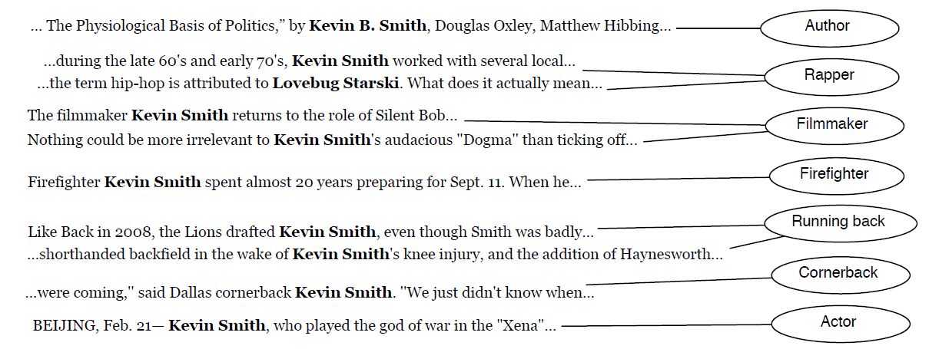
Partition mentions into entities
MENTION
CONTEXT
ENTITY
Coreference • Graphical Models • MCMC • Large Scale MCMC • Evaluation

Slide 5
Applications of Cross-document coreference
Web searches
Security databases (CIA & Big Brother)
Background checks
Trend-watching & opinion polling
News aggregation
Question answering (Watson knowledge base)
Coreference • Graphical Models • MCMC • Large Scale MCMC • Evaluation

Slide 6
Cross-document coreference is hard
Extreme ambiguity: different entities can have the same name and even belong to the same field:
George Bush and George Bush
Aliases: same entity can have lots of different names
New York City and The Big Apple
Singleton entities: sometimes an entity gets only one mention
Coreference • Graphical Models • MCMC • Large Scale MCMC • Evaluation

Slide 7
Scalable coreference?
Problem: exact inference intractable!
  Inference = maximizing the a posteriori probability of a hypothesis given some evidential support and an a priori probability of the hypothesis
Exact inference requires searching entire hypothesis space
Hypothesis space is the Bell Number in the number of mentions, defined as the number of ways to partition a set of n elements.
To label a set of mentions with the correct entity is to partition them, so set of possible solutions to coreference problem is number of possible partitions on the mentions. Factorially big.
Coreference • Graphical Models • MCMC • Large Scale MCMC • Evaluation

Slide 8
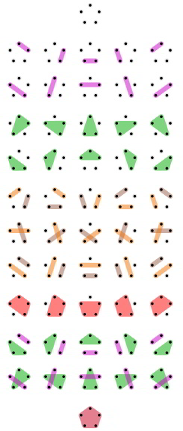
Bell Numbers
The Bell Number B(n) is the number of ways to partition a set of n elements.
B = {1,1,2,5,15,52,203,877,4140,21147,…}
Hypothesis space of this size grows super-exponentially
from Wikipedia
Coreference • Graphical Models • MCMC • Large Scale MCMC • Evaluation

Slide 9
Solution to intractable hypothesis space
Searching hypothesis space is intractable. Solutions:
Represent probability distribution as a factor graph
MCMC with simulated annealing efficiently explores hypothesis space by random sampling according to a proposal function. Converges to the highest probability as the temperature coefficient of proposal function decreases.
Distribute MCMC over many machines to make simultaneous proposals.
Hierarchical model make proposals more efficient. So many possible configurations that likelihood of finding a better configuration randomly is low: wasted sampling. Hierarchy groups entities into similar sets of super-entities and mentions into sub-entities: idea is to improve likelihood of fruitful proposals
Coreference • Graphical Models • MCMC • Large Scale MCMC • Evaluation

Slide 10
Graphical Models
A graphical model represents a family of joint probability distributions over random variables. Sample the model to get a particular likelihood given some values.
For most graphical models: one-to-one correspondence between the nodes in the graph and the random variables under consideration. They’re what can take values.
Bayesian networks: directed probabilistic graphs.
Markov random fields: undirected probabilistic graphs
Can be combined into factor graphs.
Coreference • Graphical Models • MCMC • Large Scale MCMC • Evaluation

Slide 11
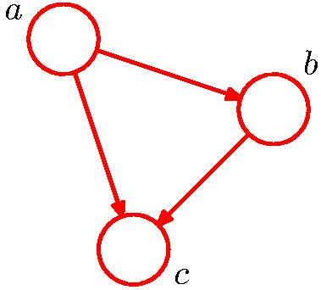
Bayesian networks
Directed probabilistic graph. Each node a random variable
Nodes only depend on parents (Markov assumption)
Explicitly indicates the conditional independence between two random variables with an arrow between the nodes.
E.G.: joint probability p(a,b,c) = p(c|a,b) * p(b|a) * p(a) from the multiplication rule of probability. Represent by:
Not the only decomposition: also could have let p(a,b,c) = p(a|b,c)*p(b|c)*p(c), which would have had different arrows
from Bishop
Coreference • Graphical Models • MCMC • Large Scale MCMC • Evaluation

Slide 12
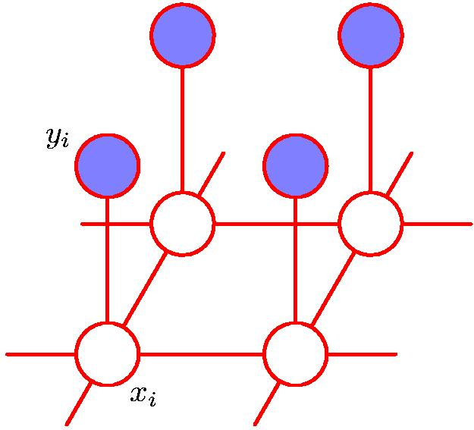
Markov random fields
Undirected probabilistic graph. Each node a random variable.
Two nodes are conditionally independent if there’s no path between them. Nodes are conditionally independent conditioning on another node if removing (or shading) that node means there’s no path between them
Conditional independence reduces the number of factors
from Bishop
Coreference • Graphical Models • MCMC • Large Scale MCMC • Evaluation

Slide 13
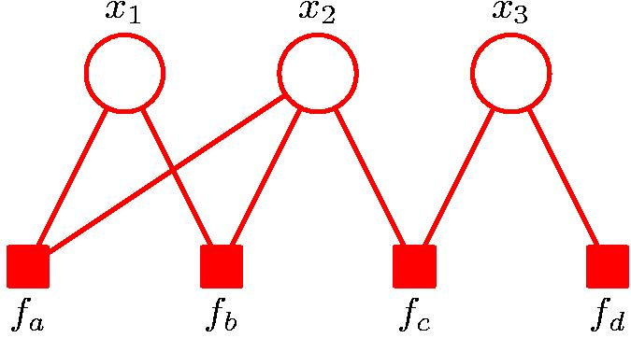
Factor graphs
Function of several variables can be factorized, expressed as a product of factors over subsets of those variables
For probability, factorization is set of factors whose product is the joint probability
Both directed, undirected graphs expressable as factor graphs
from Bishop
Coreference • Graphical Models • MCMC • Large Scale MCMC • Evaluation

Slide 14
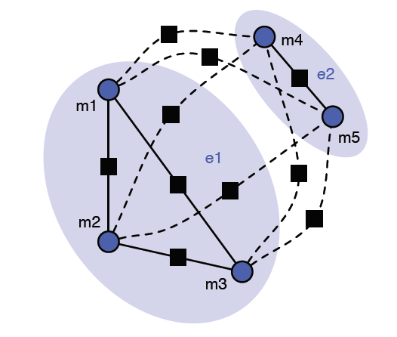
Factor graphs for Coreference
here 5 mentions and 2 entities
square nodes: factor potentials
Dashed line: REPULSION
Solid line: AFFINITY
To each node is associated a feature vector extracted from mention and context. Model is agnostic to particular features.
Coreference • Graphical Models • MCMC • Large Scale MCMC • Evaluation

Slide 15
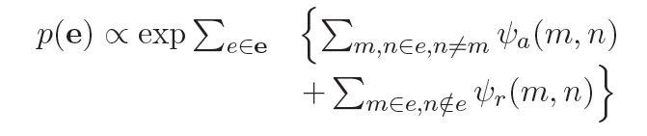
Configuration likelihood
Probability of a particular configuration:
ψ_{a}(m,n)=affinity between m and n
ψ_{r}(m,n)=repulsion between m and n
In other words: probability is the sum for all entities e in the configuration, sum of affinities between distinct nodes in e plus sum of repulsions between each node in e to every node not in e
It’s how much the mentions in an entity like each other plus how much they don’t like everyone else. This is what we want to maximize.
Coreference • Graphical Models • MCMC • Large Scale MCMC • Evaluation

Slide 16
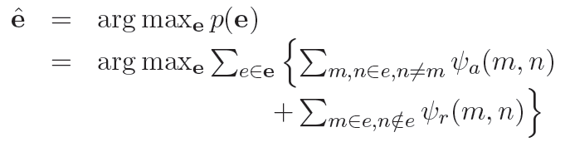
Wanted: most probable configuration
We want maximum a posteriori configuration ê:
Call the value p(e) for each e the model score. We want the configuration e with the highest model score.
Idea is to ‘sample’ from the GM’s probability distribution and change over time to improve the model score. The sampled distribution will slowly approach the true distribution
Coreference • Graphical Models • MCMC • Large Scale MCMC • Evaluation

Slide 17
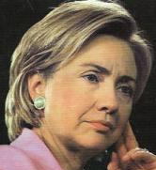
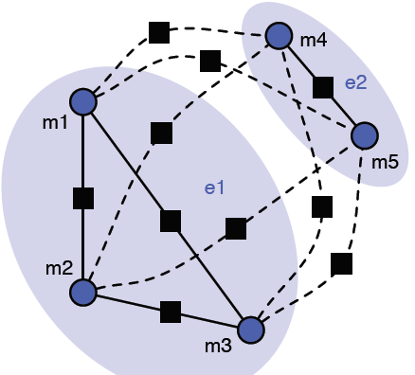
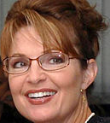
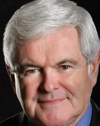
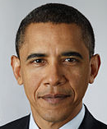
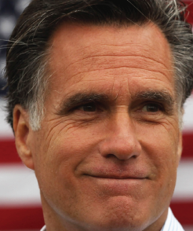
Max affinity with neighbors, repulsion with non-neighbors
Want to maximize affinity between nodes in the same subgraph and replusion between nodes in different subgraphs
The most likely configuration is the one where each node is happy to be with its
neighbor and glad to be away from everyone not its neighbor.
Coreference • Graphical Models • MCMC • Large Scale MCMC • Evaluation

Slide 18
Affinity and repulsion
Model is agnostic to particular factor potentials.
For coreference, use cosine similarity of mention context pairs:
  Φ_{mn} = cosine similarity between mentions m and n
  = cosine of the angle between their feature vectors
  Closer Φ_{mn} is to 1, closer angle is to zero, closer features are to each other
  ψ_{a}(m,n) = Φ_{mn} – b (maximizing this maximizes similarity)
  ψ_{r}(m,n) = - (Φ_{mn} – b) (maximizing this maximizes difference)
Coreference • Graphical Models • MCMC • Large Scale MCMC • Evaluation

Slide 19
With infinite time…
Would be ‘easy’ if we had infinite time: Just walk through all possible configurations one by one, calculate the probability of each, and when done select the one with highest probability
However, we’d like to finish before the sun goes supernova
Must still explore the hypothesis space (the set of possible configurations). But must explore it efficiently.
That’s MCMC: efficient exploration of a hypothesis space.
Coreference • Graphical Models • MCMC • Large Scale MCMC • Evaluation

Slide 20
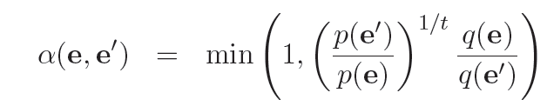
Markov Chain Monte Carlo
Walk through a sequence of hypothesized configurations such that it converges to the maximum a posteriori hypothesis.
The sequence of configurations walked through in one run is called an MCMC chain
For each configuration beginning at e₀, query a proposal function q and ask it what the next configuration should be
Accept proposal with acceptance probability given by:
This is the Metropolis-Hastings acceptance probability
t is the annealing temperature parameter
Coreference • Graphical Models • MCMC • Large Scale MCMC • Evaluation

Slide 21
Markov Chain Monte Carlo
A markov chain is a sequence of random variables in which each element of the sequence depends only on the previous element of the sequence
In our case, each configuration is generated with a proposal function on previous configuration: that makes it a markov chain
Benefit of markov chains:
  Under some situations (irreducibility and ergodicity), the markov chain will converge to some state with a probability independent of its position in the chain no matter the start state
  Means that the MCMC approaches a maximum likelihood
Coreference • Graphical Models • MCMC • Large Scale MCMC • Evaluation

Slide 22

Markov Chain Monte Carlo
“Monte Carlo” just refers to randomness (as
in the Monte Carlo Casino). Monte Carlo
methods mean that we get what we want by
a sequence of random sampling
After every sample, change the model
slightly according to proposal function
In the case of markov chains, Monte Carlo means that we get to the next element of the sequence by randomly perturbing the previous element in some way. Approach true sample distribution over time.
Coreference • Graphical Models • MCMC • Large Scale MCMC • Evaluation

Slide 23
Sampling via Proposal Functions
The proposal function returns a new configuration state e’ depending on current state e
Initial proposal function:
  randomly choose a mention and move it to a random entity.
  The resulting configuration is e’
Metropolis-hastings acceptance probability only depends on the randomly chosen mention’s old entity and the newly proposed entity; no need to calculate over whole graph
  efficient calculation, don’t need to look at all billion nodes
  will be important later for parallelization
Coreference • Graphical Models • MCMC • Large Scale MCMC • Evaluation

Slide 24
Temperature parameter: simulated annealing
The bigger the temperature, the lower the Metropolis-Hastings acceptance probability:
Lower t to increase the chance of accepting the new proposal, keep lowering the temperature more and more slowly
  start hot with big jumps at high acceptance probability to improve quickly
  slow down and get pickier as more hypothesis space is uncovered
The distribution of MCMC chains approach the best MAP probability configuration as the temperature decreases
Coreference • Graphical Models • MCMC • Large Scale MCMC • Evaluation

Slide 25
Advantages of MCMC
Efficient to evaluate a proposal because only have to look at the factors between the changed entities
Online: can stop inference at any point and the current configuration is the best one (‘anytime learning’)
Coreference • Graphical Models • MCMC • Large Scale MCMC • Evaluation

Slide 26
However…this problem is still too big!
Talking about running this on every news article written in the last 20 years. BIG space.
Even super-efficient MH-equipped MCMC is too slow.
Primarily because fruitful proposals (that is, the jumps from e to e’ that actually increase the model score, the probability of the configuration) are very very few and far between when performed randomly.
What to do to scale it up?
Coreference • Graphical Models • MCMC • Large Scale MCMC • Evaluation

Slide 27
Large-Scale Solutions
Get even more power out of MCMC by:
  distribute over many machines to do many proposals simultaneously to make proposals faster (more throughput)
  hierarchical clustering to make the proposals smarter
Coreference • Graphical Models • MCMC • Large Scale MCMC • Evaluation

Slide 28
Large-Scale Solution #1: Distribute
Key observation: to compute the acceptance probability for a particular proposal, only need to examine a few factors
Think of them as local to the particular neighborhood around the entities that q proposes get changed:
  Only disturb local neighborhood so only consider local neighborhood
  Means each local neighborhood can get its own machine
Coreference • Graphical Models • MCMC • Large Scale MCMC • Evaluation

Slide 29
How to distribute
How to divide up the set of mentions on machines:
  Start by randomly distributing the mentions/entities on different machines
  Only propose moves between entities on the same machine
  Evaluate the acceptance probability of the proposal and implement it on each machine without communicating with other machines
  Randomly redistribute the new entities and repeat
Coreference • Graphical Models • MCMC • Large Scale MCMC • Evaluation

Slide 30
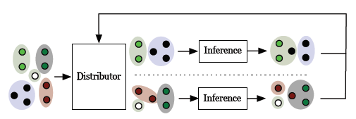
Parallel proposals
Set up same as if all the mentions were on the same machine and the proposal function was just limited to proposing swaps between two entities in a pre-set local neighborhood
But by making them on different machines, can make proposals in parallel: multiple jumps simultaneously where each jump occurs only in a local neighborhood
After proposal, randomly redistribute new entities on different machines
Coreference • Graphical Models • MCMC • Large Scale MCMC • Evaluation

Slide 31
Still not enough…
Even with local proposal functions going on simultaneously in lots of machines, still not good enough!
Want special proposals that increase configuration likelihood
Means proposals have to improve the score: must be fruitful.
Hard to find these randomly! Bigger the hypothesis space, the fewer the proportion of fruitful proposals (lots of sideways movement).
Rejection of lots of proposals = wasted time.
Coreference • Graphical Models • MCMC • Large Scale MCMC • Evaluation

Slide 32
Large-Scale Solution #2: Hierarchize
We can fix this. Two big bottlenecks to fruitfulness:
  Random redistribution during the redistribution stage - after every sampling stage randomly re-partition the entities on machines. Odds are bad that entities will come together
  Naïve proposal functions within each machine - just take a random mention off of one entity and randomly put it onto another entity, odds are bad that the mention’s new entity will be any better
So make redistribution and proposal functions smarter by adding hierarchy:
  Super-entities to make redistribution over machines smarter
  Sub-entities to make proposals smarter
Coreference • Graphical Models • MCMC • Large Scale MCMC • Evaluation

Slide 33
Block proposals and Sub-entities
Proposal function within a given machine works by proposing mention move from one random entity to another
Unlikely to be accepted. But if it is accepted, it’s evidence that the mention did not belong to its previous entity and so should also move all similar mentions from the old entity to the new!
Current proposal would take many turns to do that since it’s choosing randomly. Instead, we want to enable block proposals that move all similar entities at once
Coreference • Graphical Models • MCMC • Large Scale MCMC • Evaluation

Slide 34
Don’t want mentions stuck in blocks
Sub-entities represent groups of similar mentions within an entity. Similarity is defined by the model (explain shortly)
If sub-entities always move together, mentions would be stuck in their blocks
Instead interleave individual-mention proposals and block proposals
Treat blocks of mentions like a mention (get their own graph): each node represents a block of mentions. It has its own context feature vector.
Coreference • Graphical Models • MCMC • Large Scale MCMC • Evaluation

Slide 35
Super-entities
Random redistribution of entities onto machines also wasteful.
Want to redistribute because we want to explore all the configuration space
But don’t want to just put any old entities next to each other on the same machine
If all the entities are really different on the same machine, none of the proposals will get accepted and the machine will just be spinning its wheels for nothing, waste.
For lots of entities and machines, the probability that similar entities randomly assigned the same machine very small.
Instead, try to move similar entities onto the same machine
Coreference • Graphical Models • MCMC • Large Scale MCMC • Evaluation

Slide 36
Move similar entities onto the same machine
Super-entities represent groups of similar entities
During redistribution, ensure all entities in a super-entity end up on same machine so they can interact
This increases the chance of fruitful proposals
Again interleave random redistribution and super-entitiy redistribution, otherwise the entities in a super-entity would always be fixed together and never see any other entitiy
Coreference • Graphical Models • MCMC • Large Scale MCMC • Evaluation

Slide 37
Hierarchy
Can actually treat sub-entities / super-entities like nodes in a factor graph, with their own affinities and replusions.
Super-entities are like a little factor graph cluster of entities, and sub-entities are like mini-clusters of mentions.
Since affinity/repulsion is defined by cosine similarity between bag of words feature vectors of the context of the mentions, we need a way to define context for super and sub entities.
Coreference • Graphical Models • MCMC • Large Scale MCMC • Evaluation

Slide 38
Super/sub-entity context
Sub-entity context: need to decide if two sub-entities are similar. Use cosine similarity on the union of the bags of words of the constituent mention contexts
A super entitiy is composed of similar entities. We need to decide how two entities are similar. Take as the super-entity context the union of the sub-entity contexts for all the sub-entities in the entity
New factor graph nodes where nodes represent sub-entities and super-entities
Coreference • Graphical Models • MCMC • Large Scale MCMC • Evaluation

Slide 39
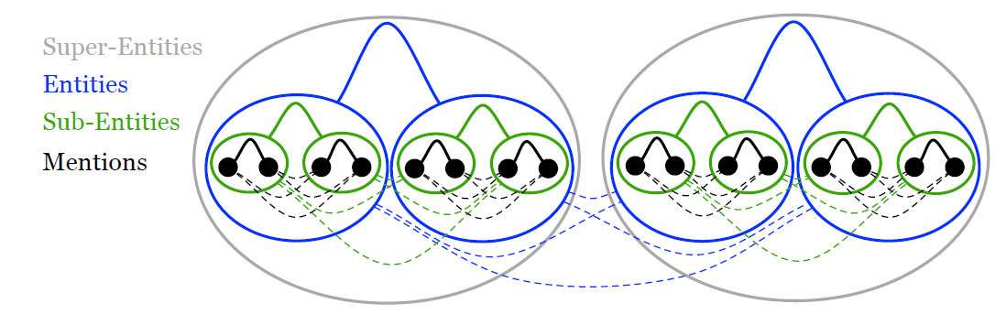
Combined hierarchical model
Now just do MCMC at all levels of the hierarchy.
Round-robin approach: first make entity movement proposals (‘sample’) at one level of the hierarchy and fix the other two, then switch to another level etc.
Initial configuration for all three hierarchy levels is singleton
Coreference • Graphical Models • MCMC • Large Scale MCMC • Evaluation

Slide 40
Experimental methodology and evaluation
Evaluate on three datasets:
  John Smith: 197 mention strings “John Smith” with 35 true entities. Compare to clustering method by Raoul (2010)
  Person-X: automatic method to create coreference corpora.
  Wikipedia: new corpus introduced here.
Use B-cubed evaluation to get precision and recall
Coreference • Graphical Models • MCMC • Large Scale MCMC • Evaluation

Slide 41
B³
Bagga, Baldwin and Biermann (1998)
Coreference chain = mentions partitioned into entities.
Need true coref chain TC and hypothesized chain HC.
For every mention, compare its HC and its TC
  Let precision be proportion of mentions in HC that are also in TC.
  Precision = HC_{true}/HC_{all}
  Let recall be proportion of mentions in TC also in HC:
  Recall = HC_{true}/TC_{all}
Total precision and recall is average over every mention
F1 score is harmonic mean of precision and recall:
  F1 = 2*(precision*recall)/(precision+recall)
Coreference • Graphical Models • MCMC • Large Scale MCMC • Evaluation

Slide 42
John Smith Corpus
197 mention strings “John Smith” with 35 true entities
Very small dataset
Model achieves B3 F1 accuracy of 66.4%
Current state-of-the-art achieves 69.7% (Rao 2010)
Competitive with much simpler features
Coreference • Graphical Models • MCMC • Large Scale MCMC • Evaluation

Slide 43
Person-X
Methodology:
  Collect a set of documents,
  Extract all named entities using a state of the art named entity recognition engine (ie, use syntax cues like capitalization and identify all strings corresponding to people names)
  filter out one-word names
  take these names as the set of entities.
  Select a random name from the entity list.
  Select all documents containing that name and replace the name in the documents with the string ‘Person-X’.
  Mention is now the string ‘Person-X’, context of the mention is the text surrounding the string, and the true entity is the name that got replaces
(Gooi and Allan 2004)
Coreference • Graphical Models • MCMC • Large Scale MCMC • Evaluation

Slide 44
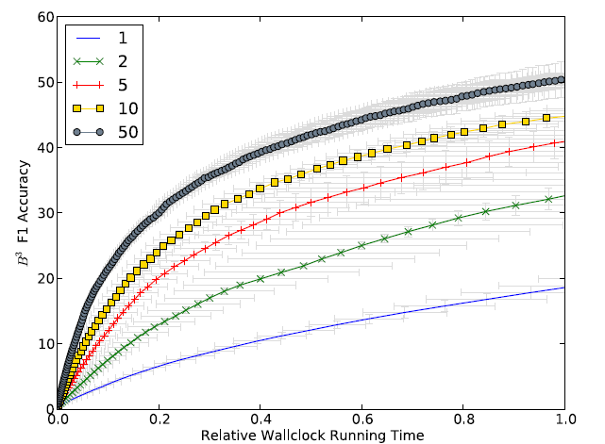
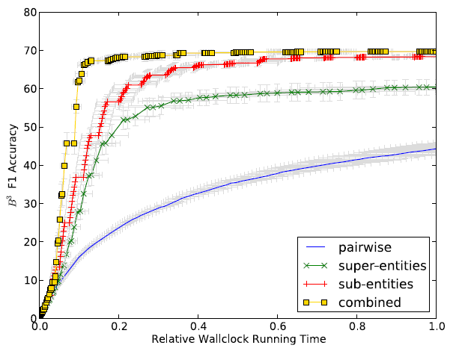
Person X on NYT Corpus
Perform Person X on the NY Times 25K person-name corpus
Use 50 different ‘Person X’ strings, e.g. Person X1,” “Person X2”, etc. to replace the 25K mentions.
One million samples (ie, a one-million mcmc sequence) in each round of inference, followed by random redistribution in the flat model and super-entities in the hierarchical. Average over five runs.
Coreference • Graphical Models • MCMC • Large Scale MCMC • Evaluation

Slide 45
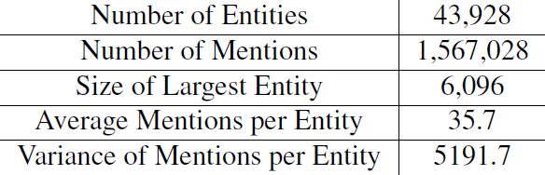
Okay so it works. But does it really scale?
Create a new cross-document coreference corpus
Treat Wikipedia page (eg http://en.wikipedia.org/Hillary_Clinton) as entity, inlinks from other pages as mentions, text block surrounding link as context. 1.5M mentions, 44K entities
Noisy, so filter: discard links with less than 36 words in block or whose anchor text (inside <a></a>) has large string edit distance from wikipedia page title. Discard ‘concepts.’ Discard entities with less than 6 links to them.
Unlike John Smith and Person-X evaluation, includes non-person entities
Coreference • Graphical Models • MCMC • Large Scale MCMC • Evaluation

Slide 46
Augment with mention-string-similarity
Augment with a mention-string-similarity score: how close are the actual mentions strings (rather than the context surrounding the mentions).
EG, “president obama” and “president barack obama” would have high mention string similarity. Affinity/repulsion looks at both mention string similarity and context string similarity:
Couldn’t do mention string similarity on the john smith and person x corpora because all mentions are the same string (ie, ‘john smith’ and ‘person x’. (those rely only on context).
Coreference • Graphical Models • MCMC • Large Scale MCMC • Evaluation

Slide 47
Baselines
Can’t compare to other methods because this dataset is so beyond them. So create our own baselines:
SubSquare: takes a weighted graph with mentions as nodes, similarity scores as edge weights; each node belongs to a cluster; randomly choose nodes and assign them to their neighbors clusters if high similarity
String-Match: just assign mentions with same mention strings to the same entities. (String-Match also used as initial configuration for hierarchical model.)
Coreference • Graphical Models • MCMC • Large Scale MCMC • Evaluation

Slide 48
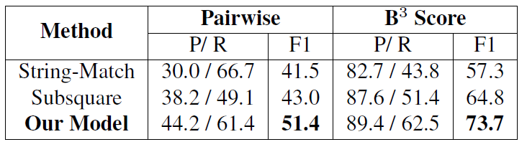
Wikipedia results
20 rounds of 10 million samples each over 500 machines
Pairwise precision and recall: consider all pairs of mentions.
  Precision is fraction that are put in same entity and are coreferent;
  Recall is fraction of coreferent pairs that are correctly put in same entity.
  Harsher test than B³
Coreference • Graphical Models • MCMC • Large Scale MCMC • Evaluation

Slide 49
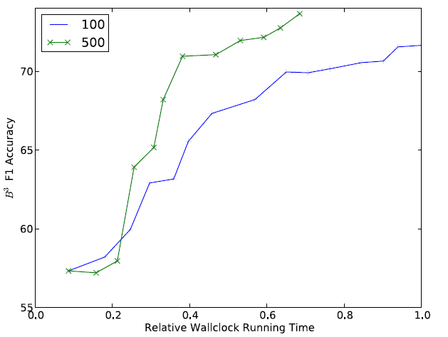
More machines = faster relative increase
Comparing relative speed between N=100 machines and N=500 machines
Coreference • Graphical Models • MCMC • Large Scale MCMC • Evaluation

Slide 50
Conclusion
Distributing over several machines increases throughput: same result in less time
Intelligent proposal functions can look at hierarchies and explore hypothesis space more quickly
It is possible to scale up coreference to web-size corpora
Coreference • Graphical Models • MCMC • Large Scale MCMC • Evaluation

Slide 51
Take home message
To quickly and intelligently explore a huge configuration space, combine MCMC chains with hierarchical models and distribute over many machines
Coreference • Graphical Models • MCMC • Large Scale MCMC • Evaluation

Slide 52
Discussion and Criticisms
Great paper, very few criticisms
It’s still cluster-esque, so maybe over-emphasis on the attempt to distinguish between this method and clustering methods
Very simple features, but that was intentional.
Unclear about bias. They say they set it to result in the correct number of entities; how does that work?
Coreference • Graphical Models • MCMC • Large Scale MCMC • Evaluation

